Slide 1


Chapter 3. Embryonic development of animals
• 1. Fertilized eggs 受精卵
• 2. Cleavage stage 卵裂期
• 3. Blastula stage 囊胚期
• 4. Gastrula stage 原肠胚期
• 5. Mesoderm formation 中胚层形成期
• 6. Neurula stage 神经胚期
• 7. Organogenetic period 器官形成期

Slide 2
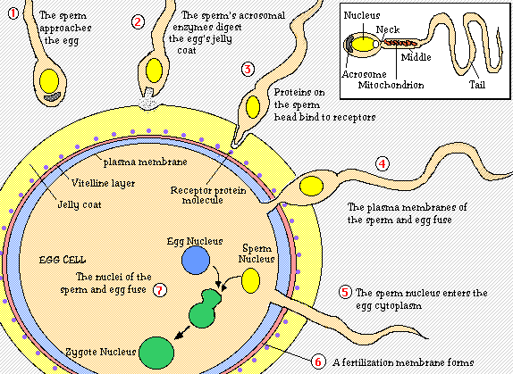
1. Fertilized eggs
顶体
卵黄层
透明带
合子细胞核

Slide 3
2. Cleavage stage
Cleavage patterns
(1) Complete cleavage完全卵裂: egg cells split completely
• equal cleavage 等裂: equal-sized daughter cells
• unequal cleavage 不等裂: unequal-sized daughter cells
(2) Partial cleavage不完全卵裂: pass partly through cells
• discal cleavage 盘裂: only on one side of the fertilized egg
• peripheral cleavage 表裂: only on surface of the fertilized egg

Slide 4
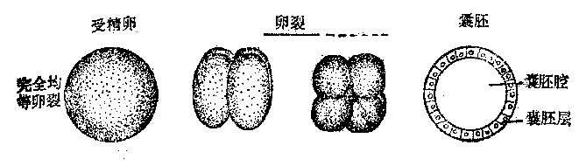
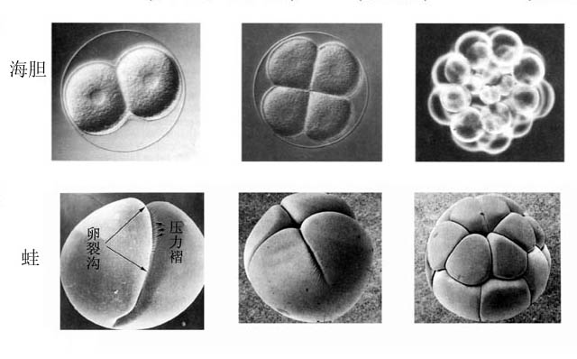
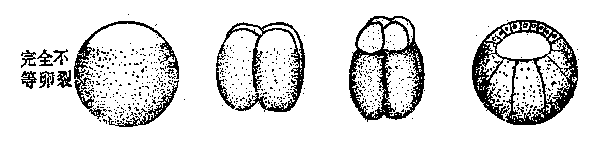
complete cleavage - equal cleavage, 卵黄少, 分布均匀：海胆
complete cleavage –unequal cleavage, 卵黄少, 分布不均匀：蛙

Slide 5
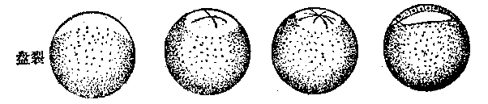
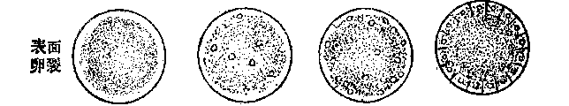
incomplete cleavage - discal cleavage, 仅发生于动物极的细胞质部位：鸡
incomplete cleavage - peripheral cleavage, 仅发生于卵表面，中黄卵：昆虫

Slide 6
Two main patterns of complete cleavage
1. Spiral cleavage 螺旋型卵裂
The upper cells are located between the lower cells
2. Radial cleavage 辐射型卵裂
The upper cells are located on the lower cells

Slide 7
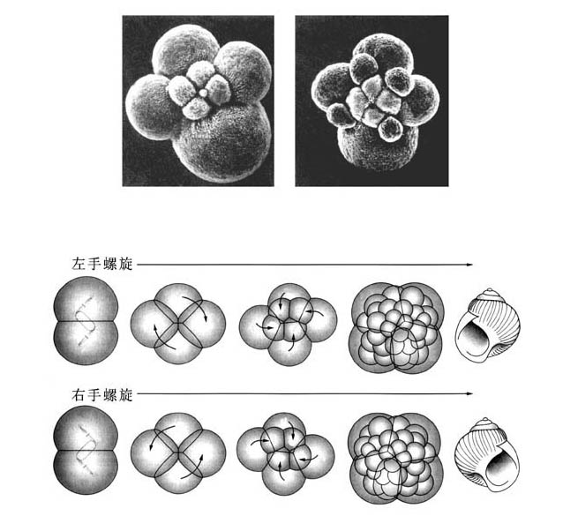
Spiral cleavage of snail

Slide 8
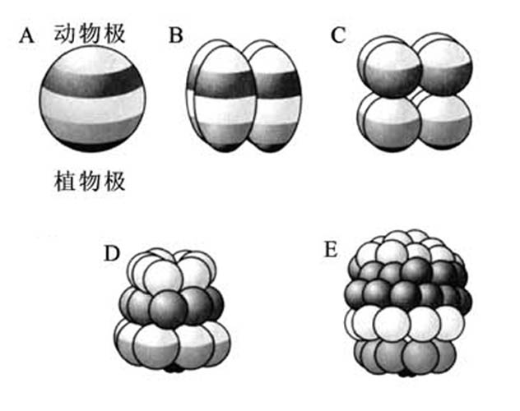
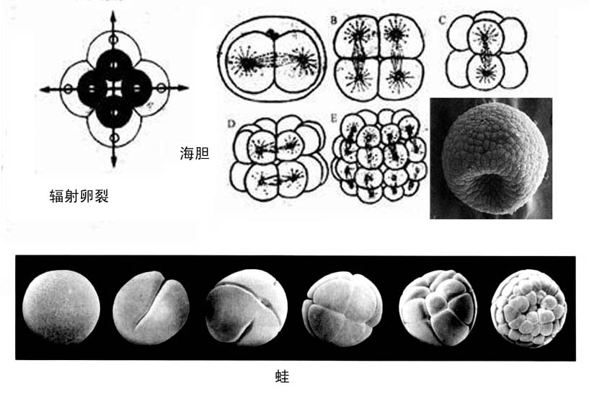
Radial cleavage of sea urchin
Radial cleavage

Slide 9
Blastula stage囊胚期
Embryonic cells up to thousands
• blastoderm 囊胚层
- blastula cells arranged in a single layer
• blastula cavity 囊胚腔
- globular, with cavity in center
Blastula cavity provides spaces for movement of embryonic cells

Slide 10
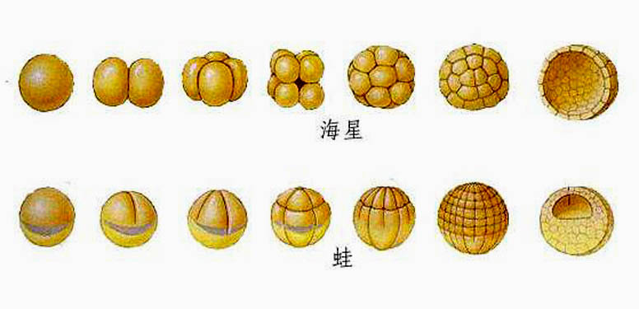
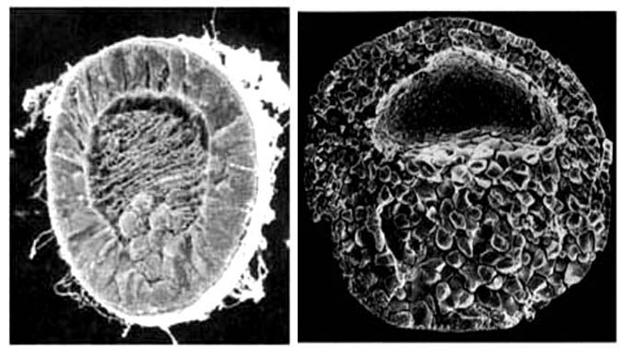
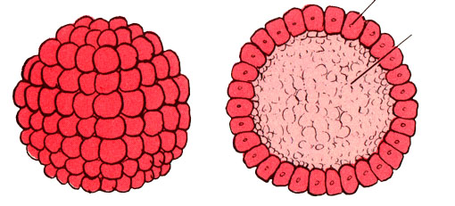
Blastula of starfish and frog

Slide 11
Gastrula stage 原肠胚期
Spatial rearrangement of blastula cells
Rearrangement patterns
• invagination 内陷
• epiboly 外包
• delamination 分层
• ingression 内移

Slide 12
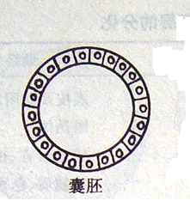
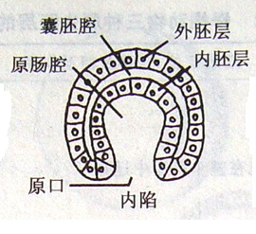
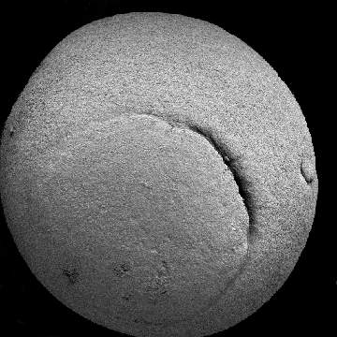
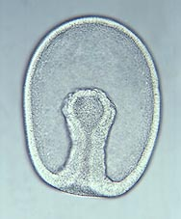
Invagination 内陷

Slide 13
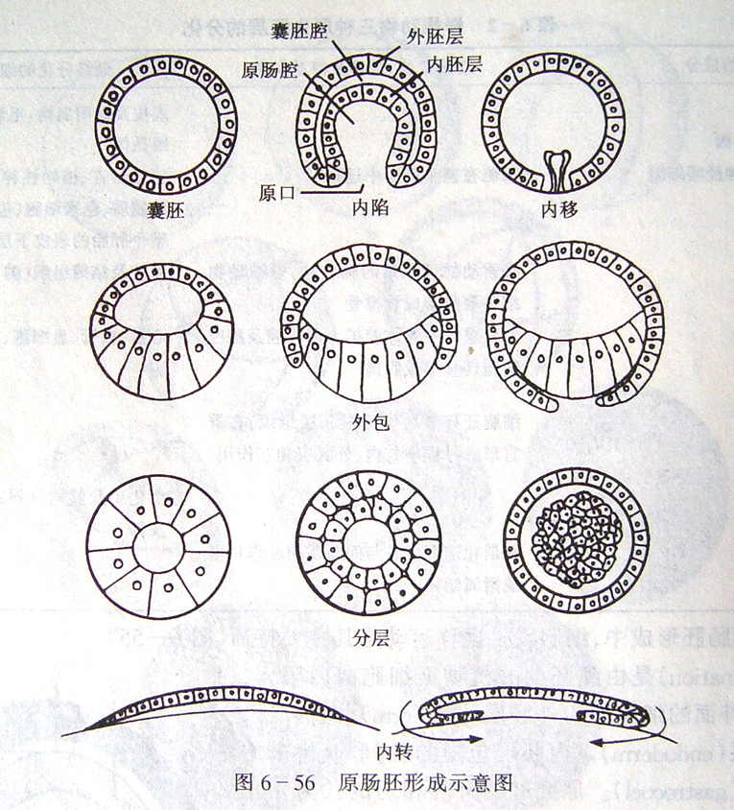
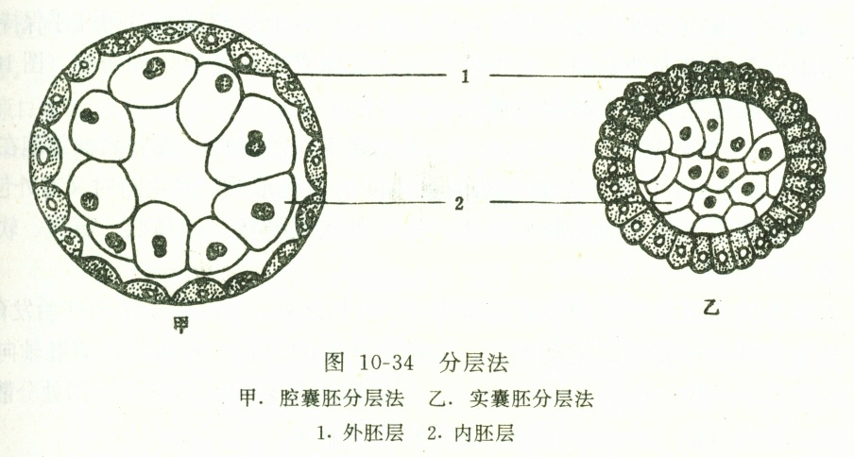
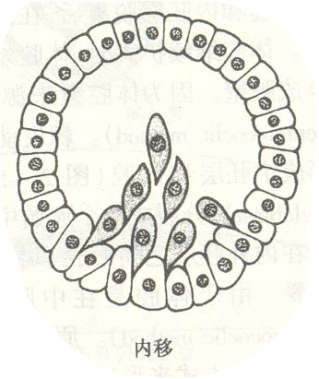

Slide 14
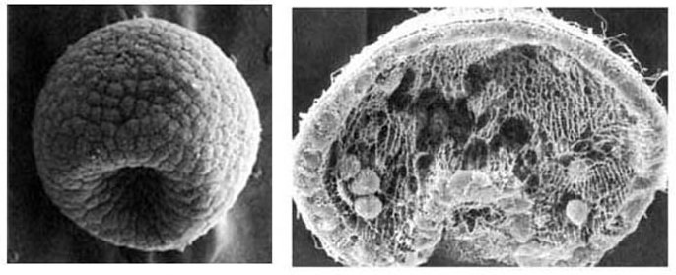
• Ectoderm 外胚层
- outer layer
• Endoderm 内胚层
- outer layer
• Gastrula cavity 原肠腔
- embraced by endoderm 内胚层
• Blastopore 胚孔
- opening to surroundings
Blastopore and gastrula of sea urchin 海胆

Slide 15
• Protostomes 原口动物
blastopore 胚孔 → mouth 口
• Deuterostomes 后口动物
blastopore 胚孔 →anus 肛门
Bilateria
两侧对称动物

Slide 16
Mesoderm formation 中胚层的形成
Blastula further develops
Patterns
• schizocoel method 裂体腔法
• coelesac method 体腔囊法

Slide 17
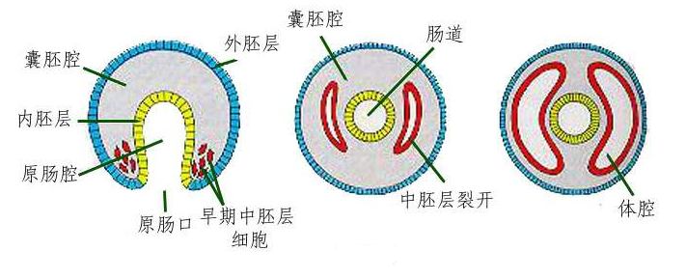
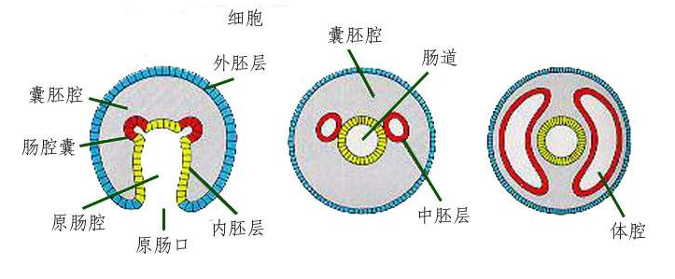
Schizocoel method
Coelesac method

Slide 18
Neurula stage 神经胚期
• neural tube 神经管
differentiate into brain and spinal cord
• notochord 脊索
chorda-mesoderm 脊索中胚层
separated from gastrula

Slide 19
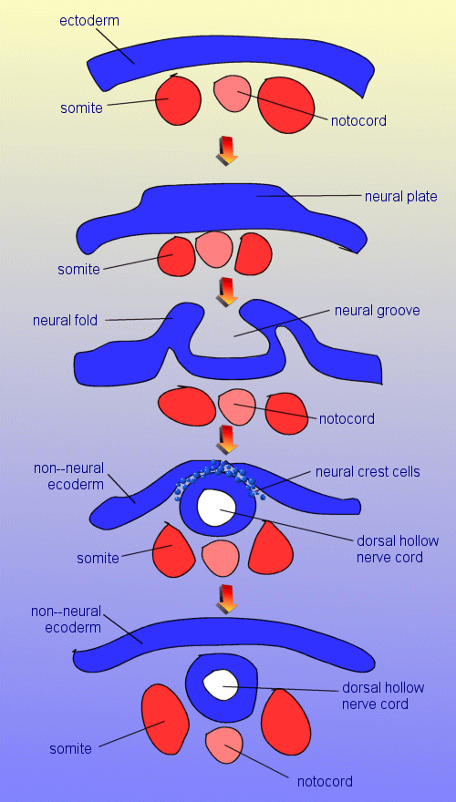
外胚层
体节
脊索
神经板
神经沟
神经嵴细胞

Slide 20
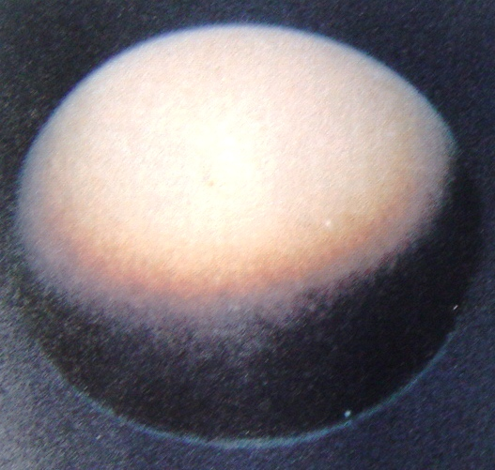
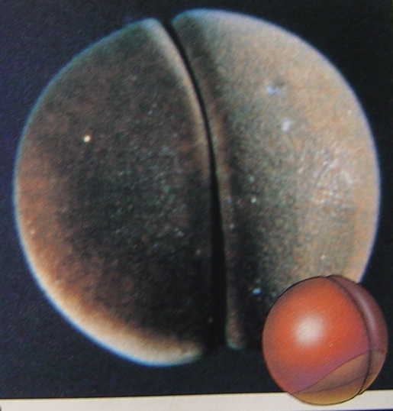
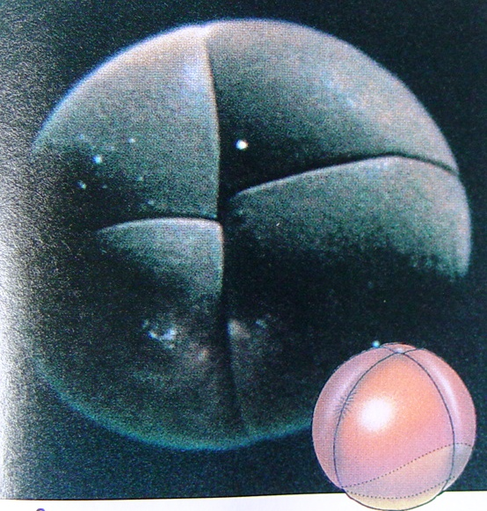
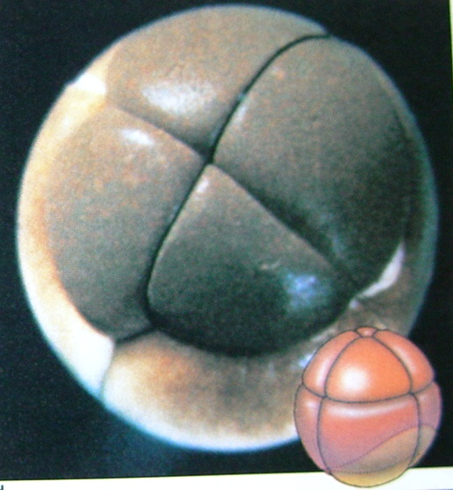
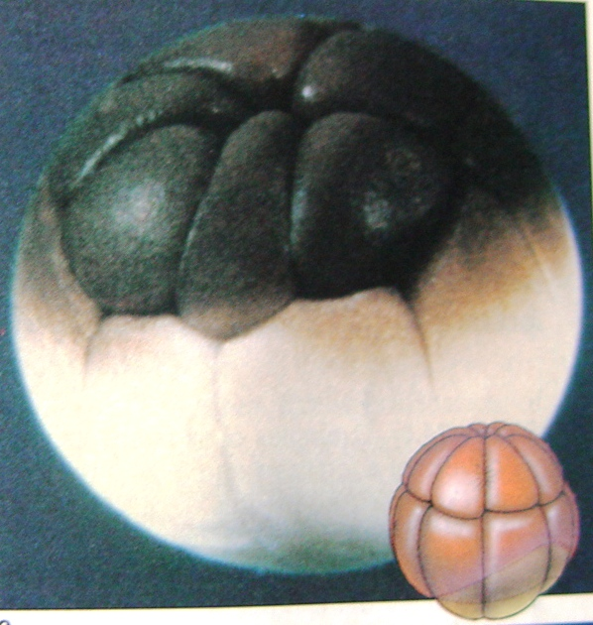
fertilized egg
2-cell stage
4-cell stage
An overview of
embryonic
development
8-cell stage
16-cell stage

Slide 21
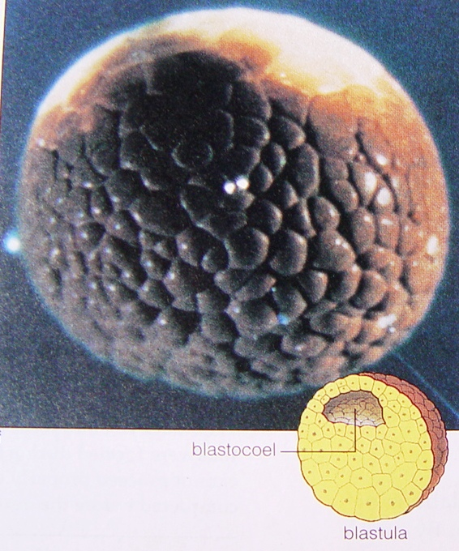
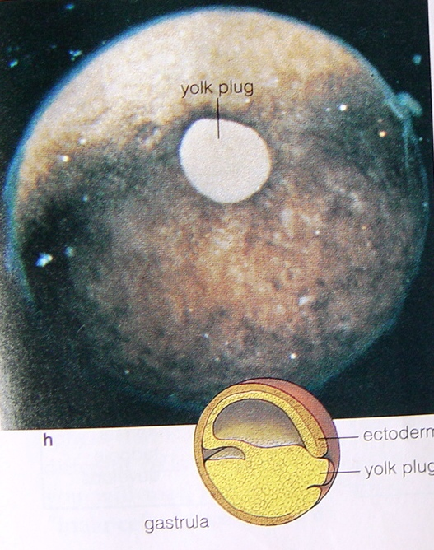
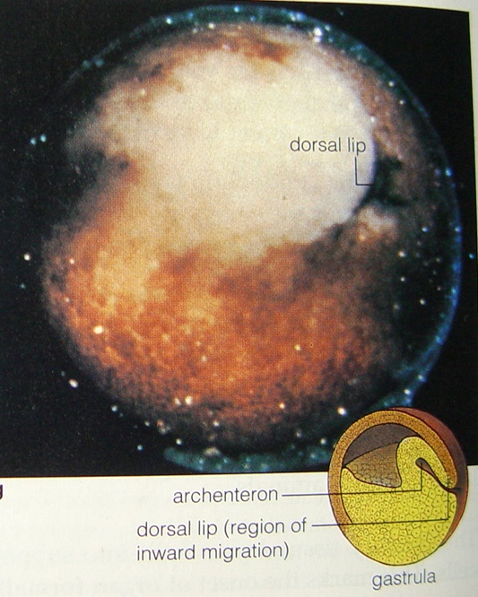
Blastula 囊胚
Gastrula 原肠胚

Slide 22
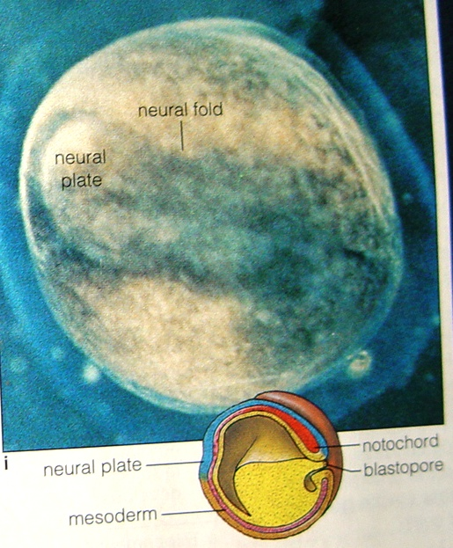
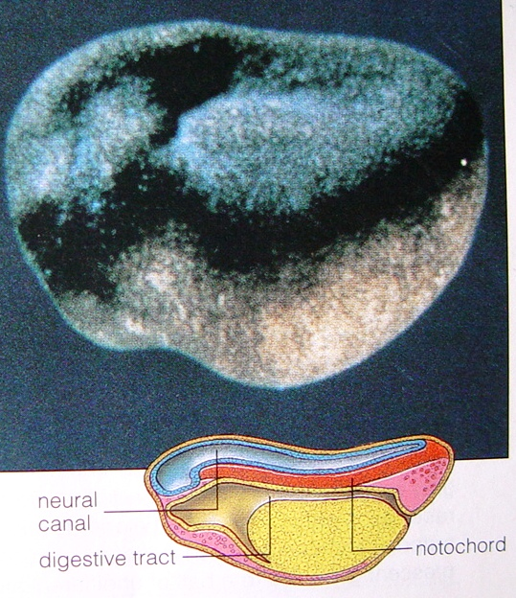
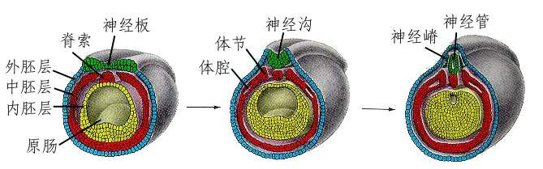
Neurula stage 神经胚期
Neurula development of frogs

Slide 23
Formation of tissues and organs
- derived from the three embryonic layers
ectoderm 外胚层 | epidermis and its derivatives
 | nervous system, sensory organs
mesoderm 中胚层 | dermis 真皮
 | notochord 脊索
 | outer membrane of internal organs 内脏器官外膜
 | muscle, circulatory system, excretory system, reproductive system
endoderm 内胚层 | epithelium of digestive tract 消化道上皮
 | epithelium of respiratory tract 呼吸道上皮
 | epithelium of urethra and urinary bladder尿道、膀胱上皮
 | glands, including liver and pancreas 胰腺

Slide 24
Chapter 4. Tissues, Organs, and Organ Systems
• 1. Tissues (key)
• 2. Organs
• 3. Organ Systems

Slide 25
Levels of biological organization - a hierarchical structure
Biosphere
Ecological system
Community
Population
Individual
System
Organ
Tissue
Cell
Organelle
Molecule
Element
Atom
Each level builds on the levels below it
Biological processes often involve several levels of biological organization
the whole > the sum of parts

Slide 26
Basic concepts
Tissue
- composed of cells which have
• the similar shape
• the same function
• the same intercellular substances 非细胞的成分
Organ
- the functional unit composed of two or more types of tissues
System
- two or more organs combine with each other and split up the work in order to finish a series of physiological functions

Slide 27
1. Tissues
1.1 Epithelial tissue 上皮组织
1.2 Connective tissue 结缔组织
1.3 Nervous tissue 神经组织
1.4 Muscle tissue 肌肉组织

Slide 28
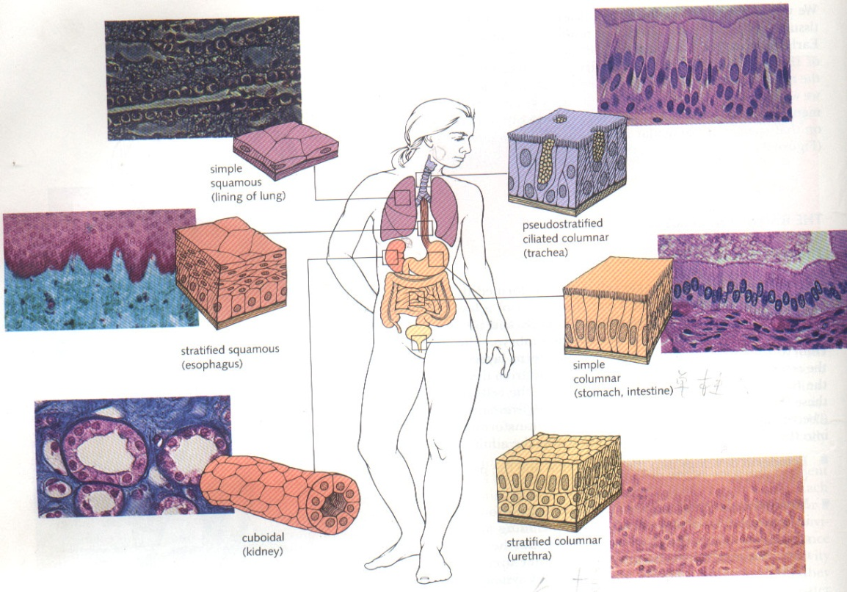
1.1 Epithelial tissue
(1) Location
• Body’s outer surface
• Inner surface of various tubes, ducts, and cavities
• Outer surface of some organs
⎯⎯

Slide 29
(2) Composition
Epithelial cells 上皮细胞 + intercellular substances 细胞间质
(3) Characteristics
● close cells, little intervening material
● exchange with connective tissues through penetration渗透
● cells have polarity, free surface and basal surface
● abundant nerve endings
(4) Functions
● Protection
● Secretion
● Absorption
● Gas exchange
● Excretion
● Sensation

Slide 30
(5) Classification (Classified by function)
Covering epithelium 被覆上皮
- distributed on the surfaces of organs
Glandular epithelium 腺上皮
- consisting of single or multiple secretory cells

Slide 31
Covering epithelium 被覆上皮
Classified by the number of epithelial cell layers and cell shape
Single layer
• Squamous epithelium 扁平上皮
• Cuboidal epithelium 立方上皮
• Columnar epithelium 柱状上皮
• Pseudostratified ciliated columnar epithelium 假复层纤毛柱状上皮
Multiple layers
• Squamous epithelium 扁平上皮
• Transitional epithelium 变移上皮

Slide 32
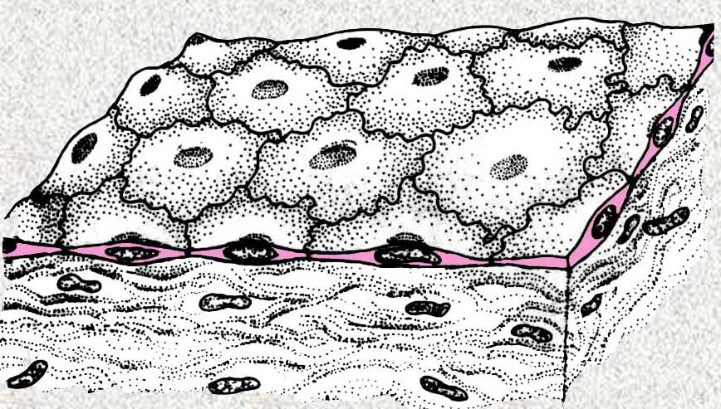
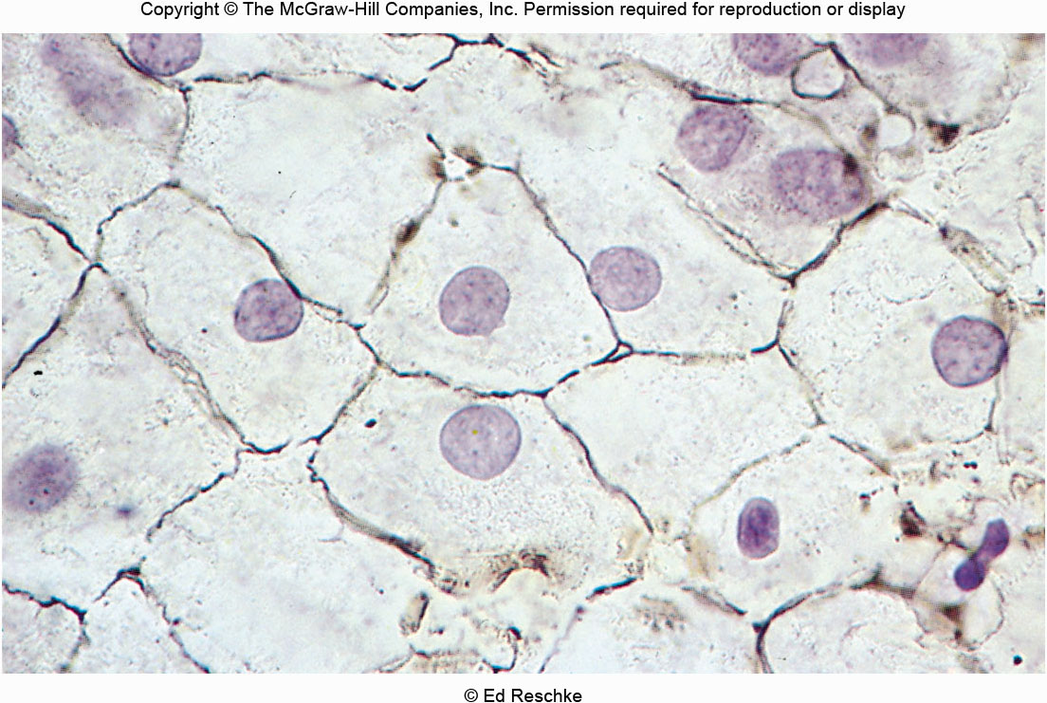
i) Simple squamous epithelium 单层扁平上皮
Composition: A single layer of tightly packed, flattened
cells with a disk-shaped central nucleus;
Location: Air sacs of the lungs, kidney glomeruli(肾小球), lining of heart(心脏内膜), blood vessels, and lymphatic vessels;
Function: Allows passage of materials by diffusion and filtration传播和过滤

Slide 33
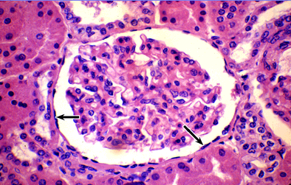
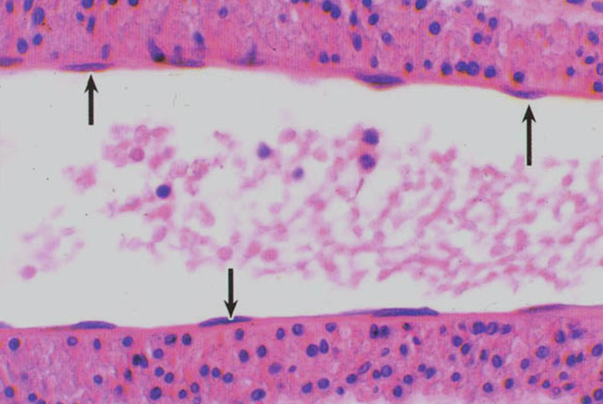
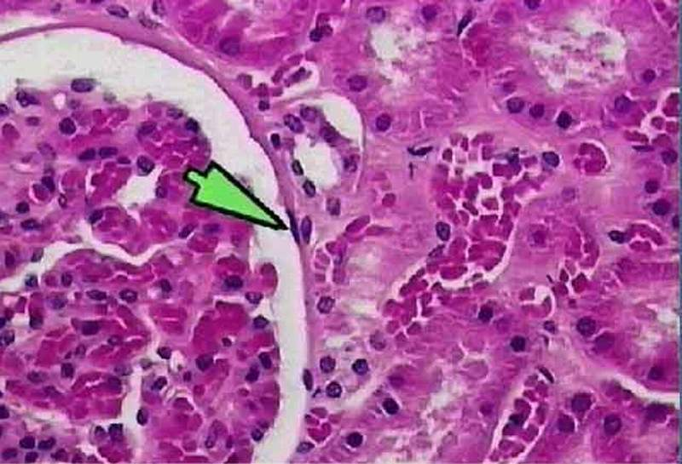
单层扁平上皮-血管内皮
单层扁平上皮-肾小囊壁层

Slide 34
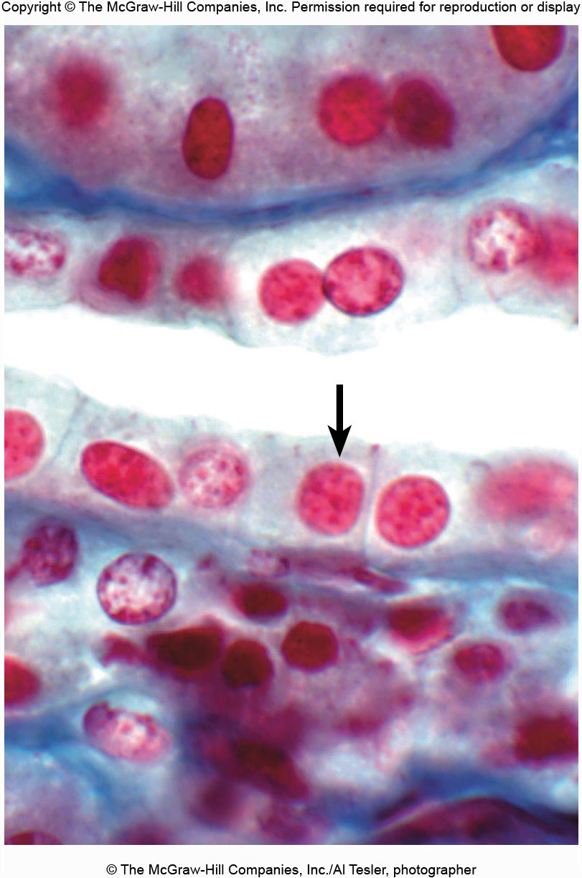
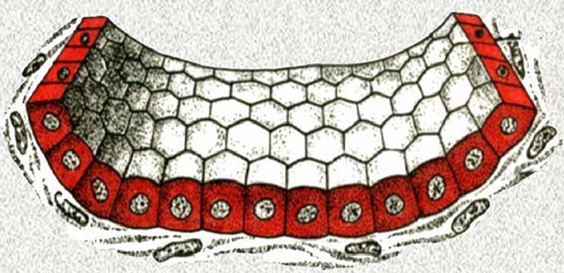
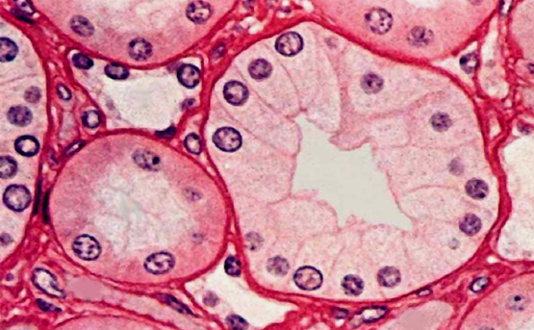
ii) Simple cuboidal epithelium 单层立方上皮
Composition: A single layer of tightly packed,
cube-shaped cells; arrow indicates the cell layer.
Location: Kidney tubules, ducts and small glands,
and surface of ovary.
Function: Secretion and absorption
单层柱状上皮-肾小管和集合管

Slide 35
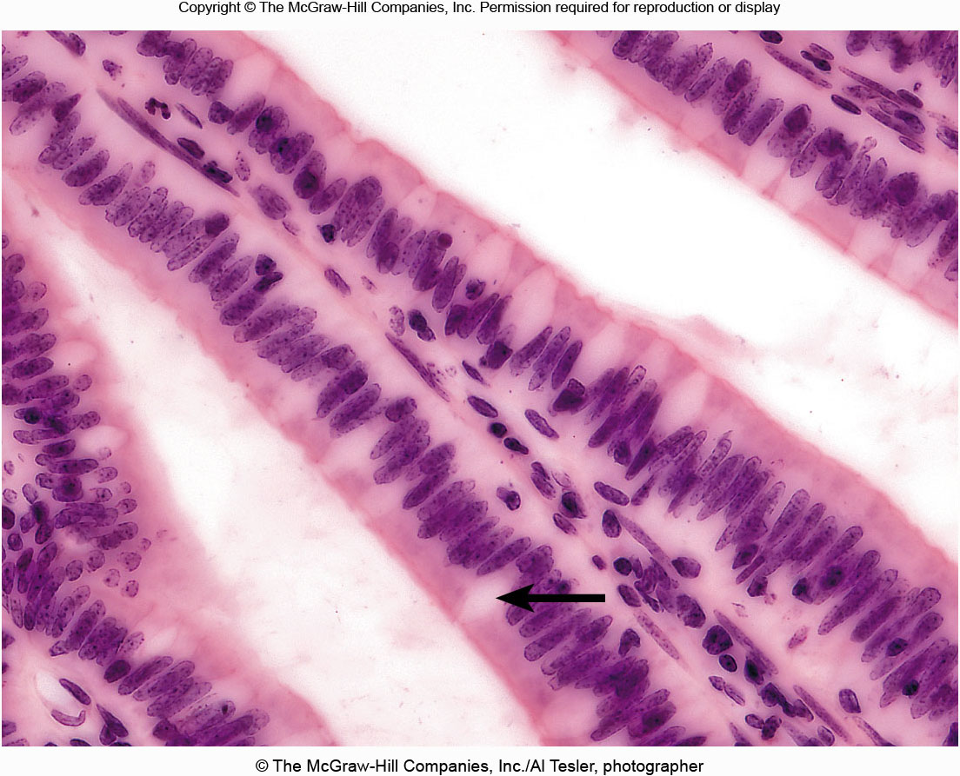
iii) Simple columnar epithelium 单层柱状上皮
Composition: A single layer of elongated cells; the arrow points to a specialized
goblet cell 高脚杯细胞 that secrets mucus粘液.
Location: Lines digestive tract, gallbladder, and excretory ducts of some glands.
Function: Absorption, enzyme secretion.

Slide 36
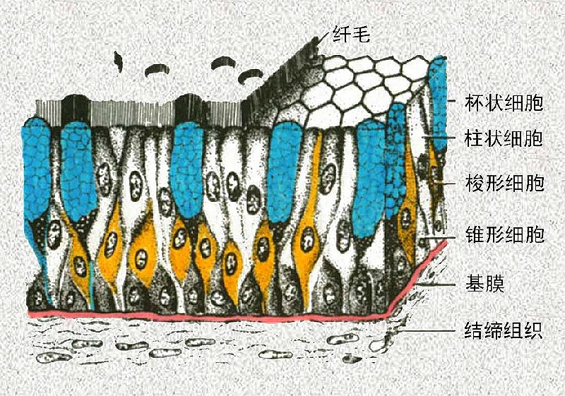
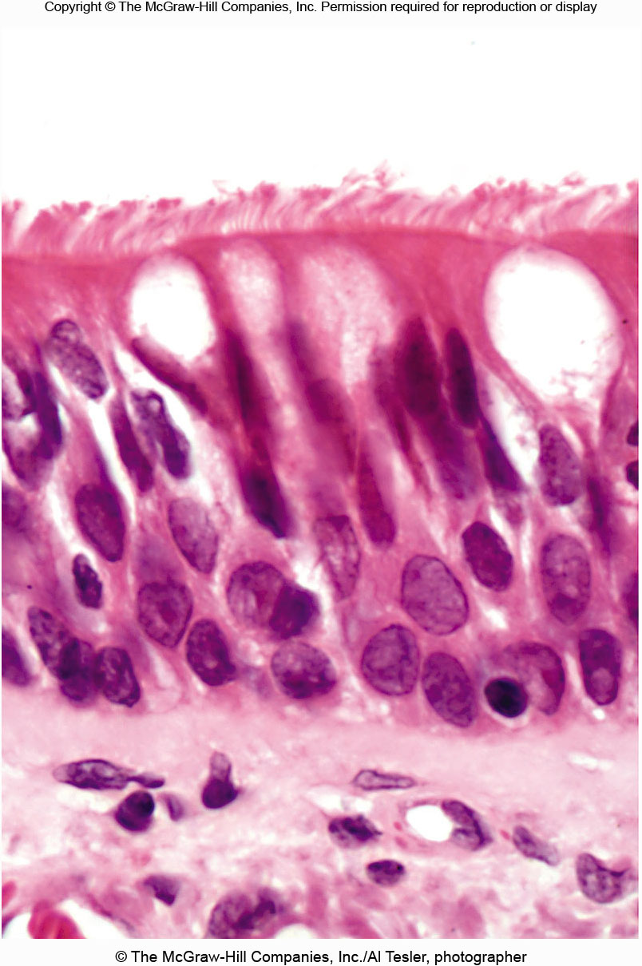
iv) Pseudostratified ciliated columnar epithelium 假复层纤毛柱状上皮
假复层纤毛柱状上皮模式图
Composition: A tuft of cilia tops each columnar cell, except for goblet cells.
Location: Lines the bronchi支气管内膜, uterine tubes输卵管, and some regions
of the uterus子宫.
Function: Propels推进 mucus or reproductive cells by ciliary action.

Slide 37

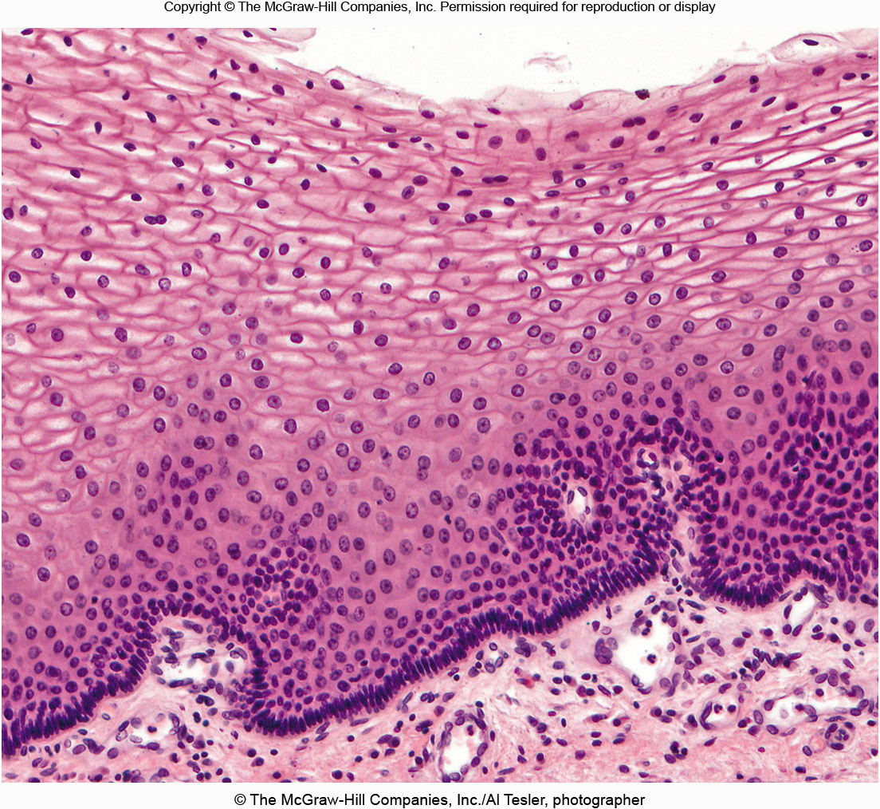
v) Stratified squamous epithelium 复层扁平上皮
Composition: consists of many layers of cells.
Location: Lines the esophagus食道, mouth, and vagina.
Keratinized variety lines the surface of the skin.
Function: Protects underlying tissues subject to abrasion磨损.

Slide 38
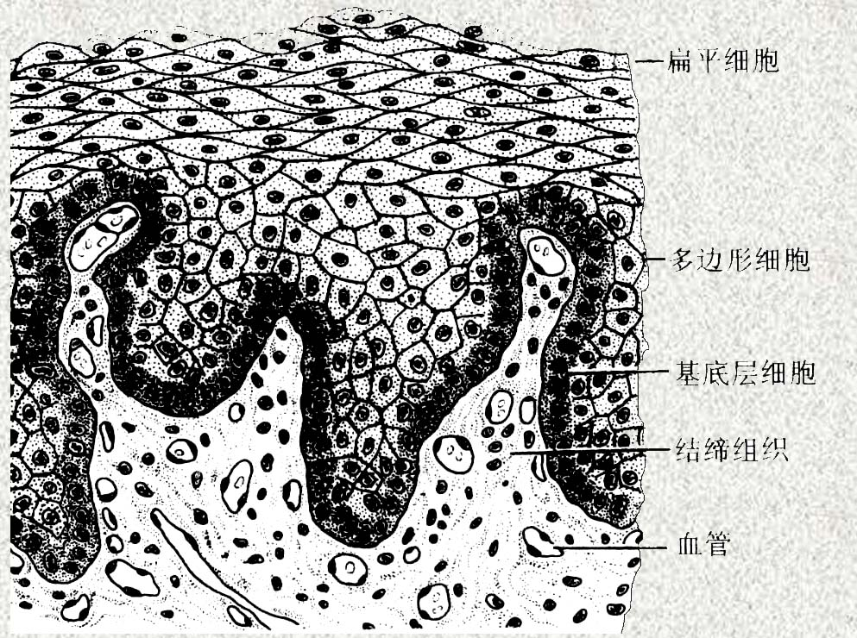
复层扁平上皮模式图

Slide 39
vi) Transitional epithelium变移上皮
Composition: consists of many layers of epithelium cells
that can contract and expand.
Location: renal pelvis肾盂, renal calices肾盏, ureter 输尿管,
urinary bladder膀胱.
Function: accommodates fluctuation of volume of the liquid
in an organ or tube, such as the urinary bladder, and protect
against the caustic effects of urine尿的腐蚀性

Slide 40
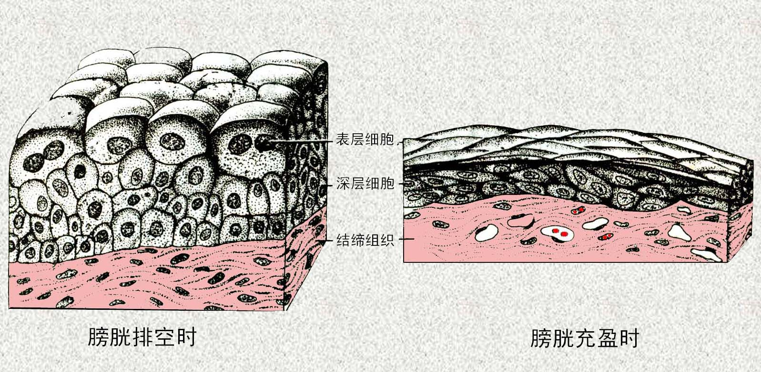
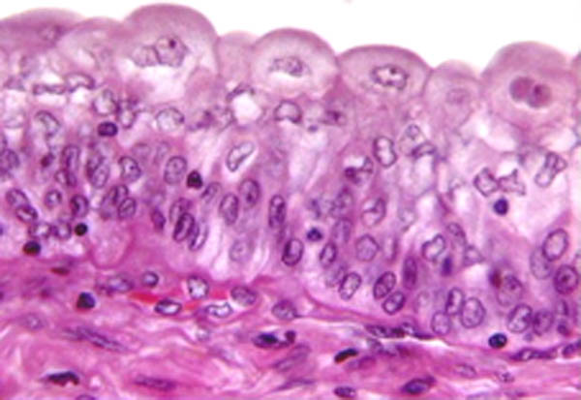

变移上皮模式图-膀胱
变移上皮光镜图-膀胱排空时
变移上皮光镜图-膀胱充盈时
Transitional epithelium变移上皮

Slide 41
vii) Glandular epithelium腺上皮
Composition: consists of consisting of single or multiple
cells that produce secretions.
Location: Single cells disperse in the epithelium of
respiratory tract or digestive tract, e.g. goblet-like cells 杯状细胞
Function: Secretion

Slide 42

Single cells or multiple cells glandular epithelium

Slide 43



Exocrine gland
外分泌腺

Slide 44
1.2 Connective tissue结缔组织
• Function: Connection and Support
• Composition: Cells and intercellular materials (fiber and
ground substances基质)
• Classification (based on ground substances):
(1) Connective tissue proper 固有结缔组织
- colloidal ground substance 胶态基质
(2) Cartilage tissue软骨组织
- semisolid ground substance
(3) Bone tissue 骨组织
- solid ground substance
(4) Blood tissue 血液
- liquid ground substance
⎯⎯

Slide 45

(1) connective tissue proper 固有结缔组织
Adipose tissue 脂肪组织
Loose connective tissue 疏松结缔组织
Dense connective tissue 致密结缔组织
i) Adipose tissue (The arrow indicates a nucleus)
Composition: cells contain large fat
droplets that push the nuclei close to
the plasma membrane.
Location: Around kidney, under skin,
in bones, within abdomen, and in
breasts.
Function: Provides reserve fuel,
insulates against heat loss隔绝热能损失,
Supports and protects organs.
⎯⎯

Slide 46

ii) Loose connective tissue
Composition: contains numerous
fibroblasts (arrows) that produce
collagenous and elastic fibers胶状和
弹性纤维.
Location: Widely distributed under
The epithelia of the human body.
Function: Wraps and cushions organs
包裹和缓冲
Fibroblast
成纤维细胞

Slide 47

iii) Fibrous connective tissue
or dense connective tissue
The arrow points
to a fibroblast.
Composition: contains largely tightly packed collagenous fibers
Location: Dermis 真皮层of the skin, submucosa 粘膜下层of the digestive tract, and fibrous capsules纤维囊 of organs and joints.
Function: Provides structural strength.

Slide 48

(2) cartilage 软骨组织
i) Hyaline cartilage 透明软骨
ii) Elastic cartilage 弹性软骨
iii) Fibrocartilage 纤维软骨
Composition: cells are located in
lacunae陷窝(arrow) surrounded by
intercellular material containing fine
collagenous fibers.
Location: Forms embryonic skeleton;
covers ends of long bones; and forms
cartilage of nose, trachea气管, and
larynx.
Function: Support and reinforcement.
i) Hyaline cartilage 透明软骨

Slide 49

ii) Elastic cartilage 弹性软骨
Composition: contains fine collagenous fibers and many elastic fibers in its intercellular material.
Location: External ear, epiglottis会厌
Function: Maintains a structure’s shape while allowing great flexibility.

Slide 50

iii) Fibrocartilage 纤维软骨
Composition: contains many large, collagenous fibers in its
intercellular material.
Location: Intervertebral disks, pubic symphysis耻骨联合, and disks
of knee joint.
Function: Absorbs compression shock 压缩震动.

Slide 51

(3) Bone tissue骨组织
Composition: Bone matrix is deposited in concentric 同心layers around osteonic canals.
Location: Bones.
Function: Supports, protects, provides lever system for muscles to act on, stores calcium and fat, and forms blood cells.

Slide 52

(3) Blood tissue
Composition: consists of red blood cells, white blood cells, and platelets suspended in an intercellular fluid (plasma)血浆
Location: Within blood vessels
Function: Transports oxygen, carbon dioxide, nutrients, wastes, hormones, minerals, vitamins, and other substances.

Slide 53

1.3 Nervous tissue 神经组织
Composition: Consists of neurons.
Location: Brain, spinal cord, and nerves.
Function: Transmits electrical signals from sensory receptors to the spinal cord or brain, and from the spinal cord or brain to effectors 效应器(muscles and glands)

Slide 54

1.4 Muscle tissue 肌肉组织
横纹
i) Skeletal muscle tissue
Composition: Consists of striated muscle fibers (cells) that are long and cylindrical圆柱 and contain many peripheral nuclei外围核.
Location: In skeletal muscles attached to bones.
Function: Voluntary movement, locomotion

Slide 55


ii) Smooth muscle tissue
Composition: Consists of spindle-shaped cells狭长, each containing a single centrally located nucleus (arrow). Cells are arranged closely to form sheets. Smooth muscle tissue is not straited.
Location: Mostly in the walls of hollow organs.
Function: Moves substances or objects (foodstuff, urine, a baby) along internal passageways; involuntary control.

Slide 56


iii) Cardiac muscle tissue
闰盘
Composition: Consists of branched striated cells, each containing a single nucleus and specialized cell junctions called intercalated disks that allow ions to move quickly from cell to cell.
Location: The walls of the heart.
Function: propels blood into the circulation; involuntary control.

Slide 57

The origin of eukaryotic cells

Slide 58

2. Organs
Functional units of an animal’s body that are made up of more than one type of tissue.
Abdominal organs
of a human

Slide 59
3. Organ systems
An organ system is an association of organs that together performs an overall function. Examples include integumentary皮肤, skeletal, muscular, nervous, endocrine, circulatory, lymphatic淋巴, respiratory, digestive, urinary, and reproductive systems (see details in table 2.4 in the english textbook).

Slide 60
Next lecture
Chapter 5. Classification and systematics of Animalia
Chapter 6. Protozoa

